Slide 1
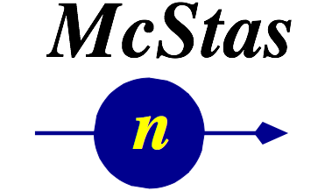





McStas Introduction

Slide 2
Agenda
A (very) brief introduction to Monte Carlo & raytracing
Components of neutron instruments
How McStas works under the hood
Components and instruments
A demo

Slide 3
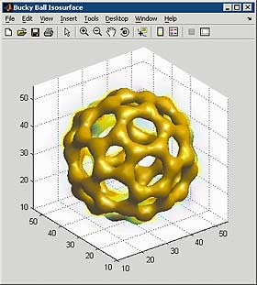
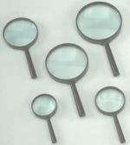
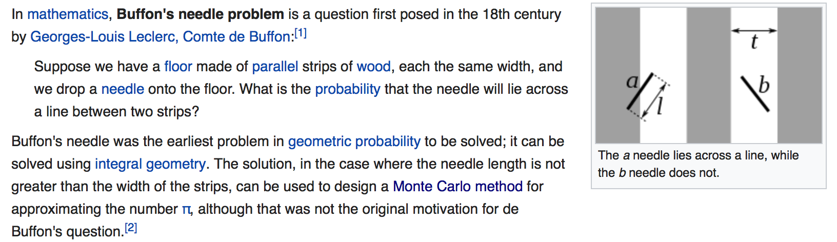
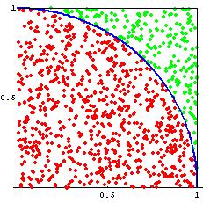
Monte Carlo methods
Dimensionality of phase space must be large (d > 5)
Overall complexity is beyond reasonable analytical methods
Each event can be computed easily and independently MC is the 'lazy guy' method – think microscopic
Examples:
Estimate π from a circle/square (“Buffon needle”)
Area under/inside a curve/volume (integration)
Molecular Dynamics
spin-system phase transitions (Ising model)
nuclear reactions
ray-tracing (light, particles)
π
Number of points for which
{ x²+y²≤ 1, (x,y) ∈ [0,1] }
Ratio circle/square → π/4

Slide 4
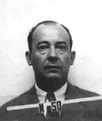
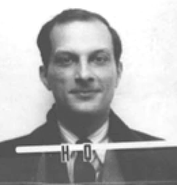
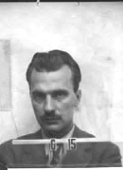
Origin of Monte Carlo methods
Used by Nature since ... (a long time) : diversity of Life
First application using computers:
Metropolis, Ulam and Von Neumann at Los Alamos, 1943
Neutron Scattering and Absorption in U and Pu, Origin of MCNP
Name:
Monte Carlo casino, a random generator (Ulam’s father played poker)

Slide 5
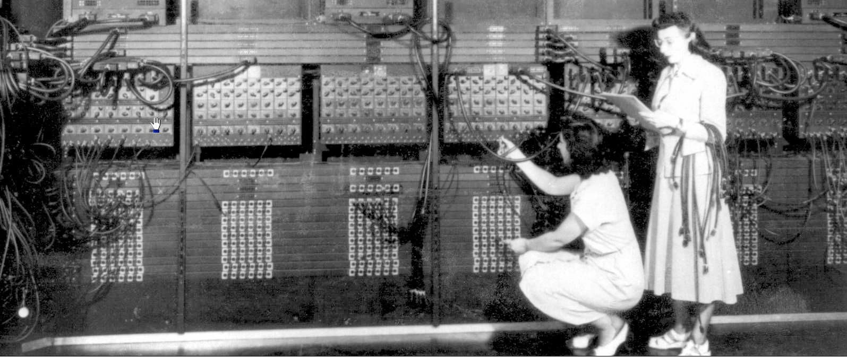
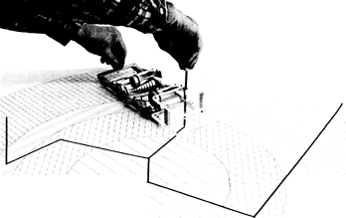
Monte Carlo techniques
ENIAC
FERMIAC

Slide 6
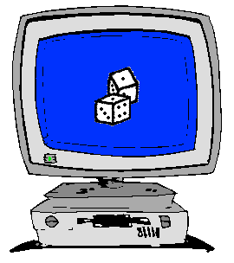
How to implement Monte Carlo methods ?
Good random generator:
from thermal electronic noise (hardware)
or quasi-random generators => quasi-Monte-Carlo
We encounter a probability 0 < p < 1.
Crude Monte-Carlo (yes/no choice):
We shoot n events ξ ∈[0,1]
We keep events that satisfy ξ < p
np events → low statistics
Importance sampling (fuzzy choice – event weighting):
Keep n events, no more random number...
But associate a weight p to each of them (we set ξ = p)
Retain statistical accuracy (1/÷n)

Slide 7
Examples of Monte Carlo programs
Each time physics takes place (scattering, absorption, …)
random choices are made.
Light ray-tracing: PoV-RAY and others ...
Nuclear reactor simulations (neutron transport):
MCNP, Tripoli, GEANT4, FLUKA
Neutron Ray-Tracing propagation:
McStas <www.mcstas.org>, Vitess, Restrax, NISP, IDEAS
Neutrons are described as (r, v, s, t), and are transported along
instrument models.
Propagation simply uses Newton rules, incl. gravitation.
X-ray tracing
Shadow, McXtrace, RAY, …

Slide 8
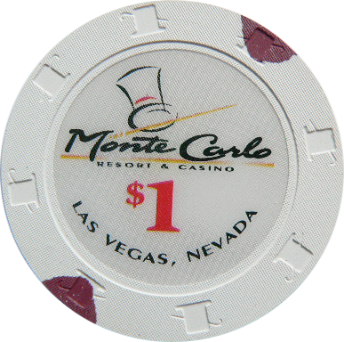
Monte Carlo techniques
Los Alamos has since then developed and perfected many different monte carlo codes leading to what is today known as the codes MCNP5 and MCNPX
State of the art is MCNPX (or soon the merged MCNP6 code) that features numerous (even exotic) particles
MCNP was originally Monte Carlo Neutron Photon, later N-Particle
Mainly used for high-energy particle descriptions in weapons, power reactors and routinely used for estimating dose rates and needed shielding
Does not to date handle coherent scattering of neutrons due to the focus on high energies

Slide 9
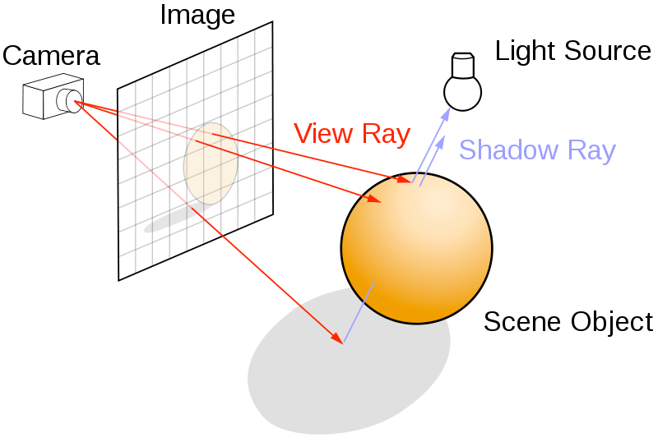
Ray-tracing methods
When neutrons move in “free space”, we use ray-tracing - but in most cases in direction source -> detector
Of course parabolas rather than straight lines are uses to implement gravity

Slide 10
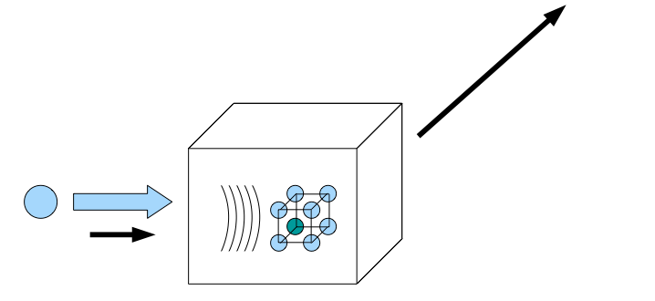
Elements of Monte-Carlo raytracing
Instrument Monte Carlo methods implement coherent scattering effects
Uses deterministic propagation where this can be done
Uses Monte Carlo sampling of “complicated” distributions and stochastic processes and multiple outcomes with known probabilities are involved
- I.e. inside scattering matter
Uses the particle-wave duality of the neutron to switch back and forward between deterministic ray tracing and Monte Carlo approach
Result: A realistic and efficient transport of neutrons in the thermal and cold range

Slide 11
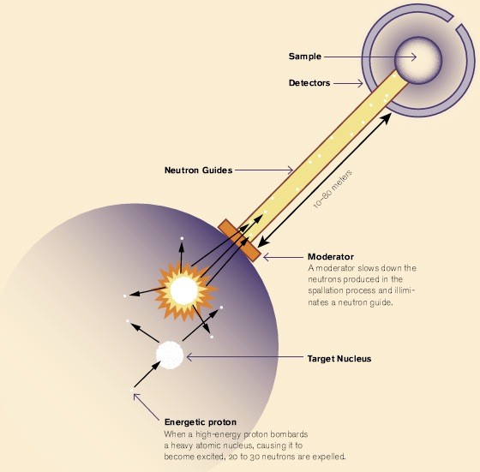
Components of neutron instruments

Slide 12
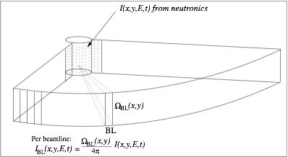
Moderators... (Where McStas starts)

Slide 13
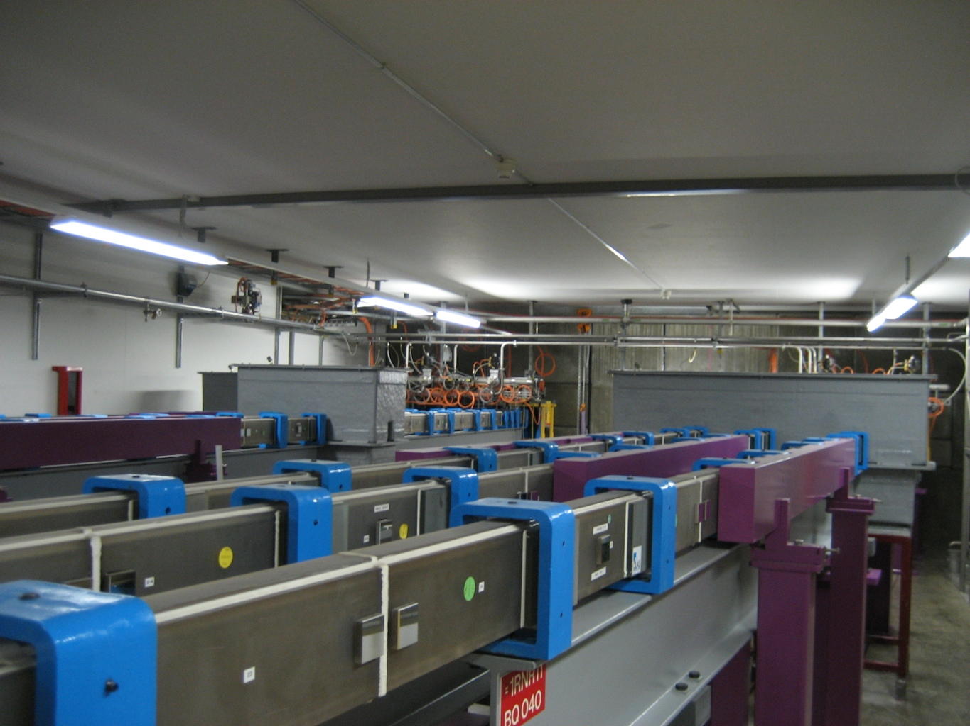
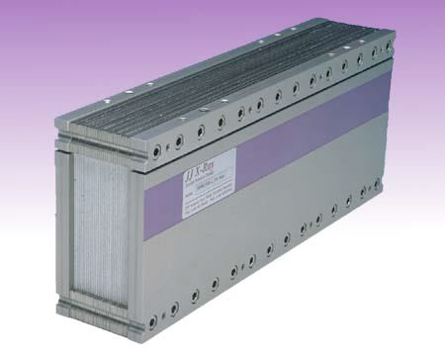
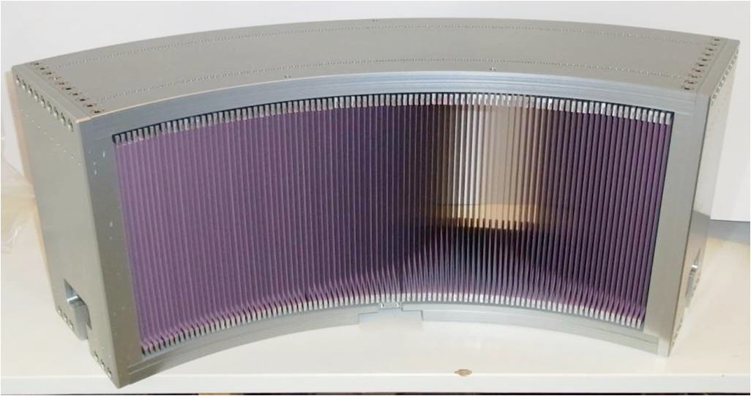
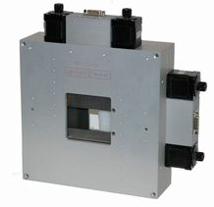
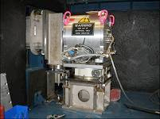
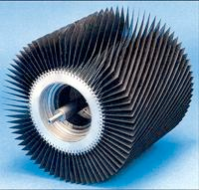
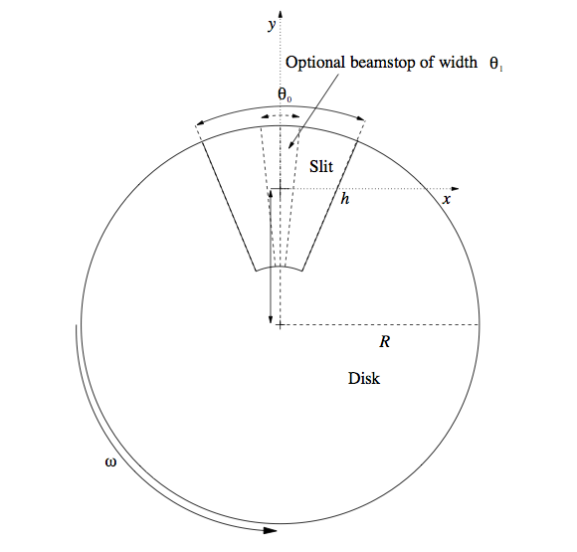
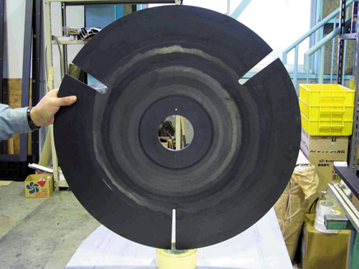
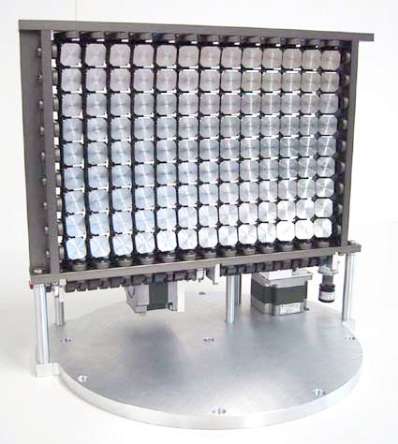
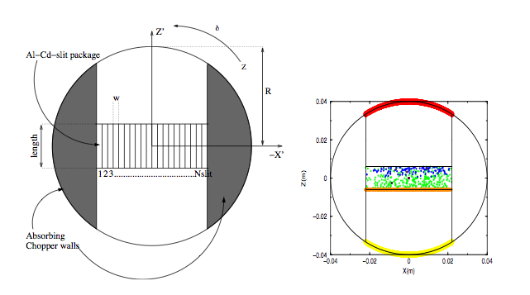
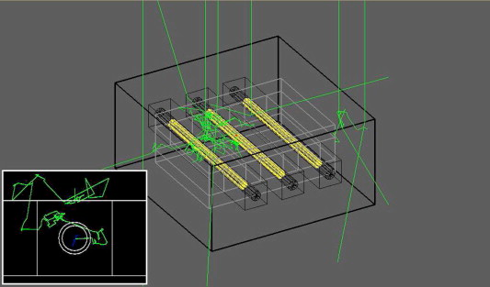
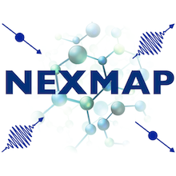
Neutron optics and other instrument components
MDANSE2018
Text
Text
MDANSE 2018, Puerto de la cruz, Tenerife

Slide 14
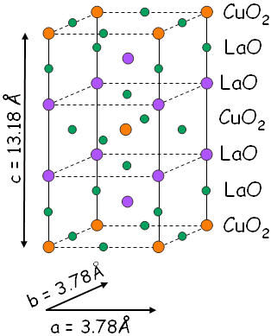
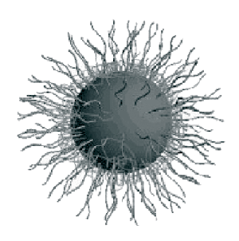
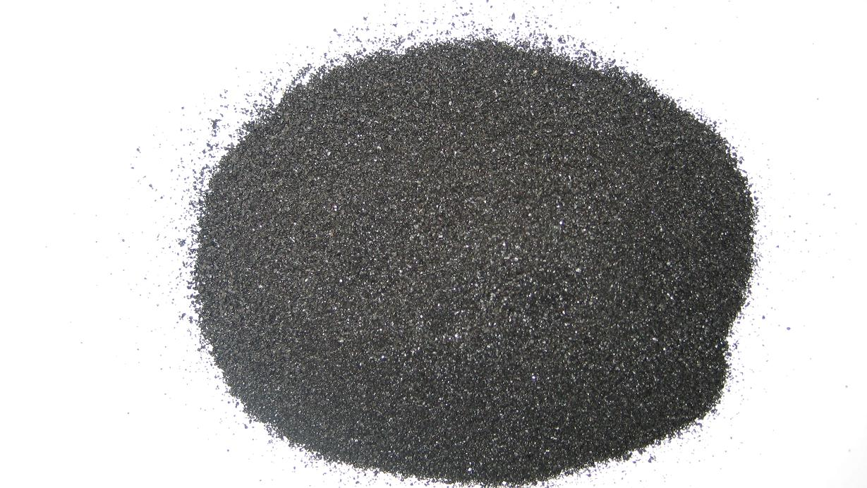
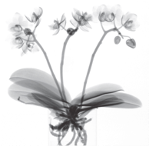
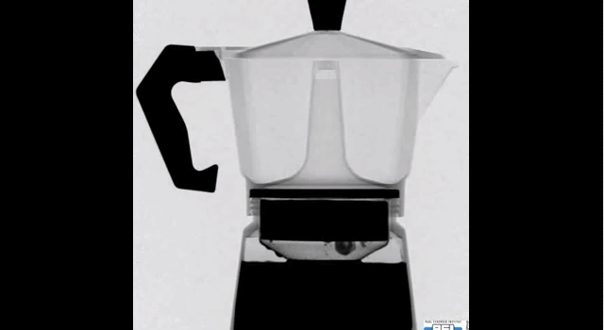
Samples studied...

Slide 15
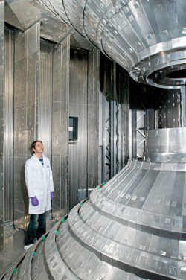
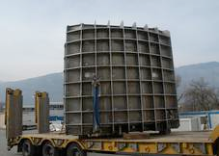
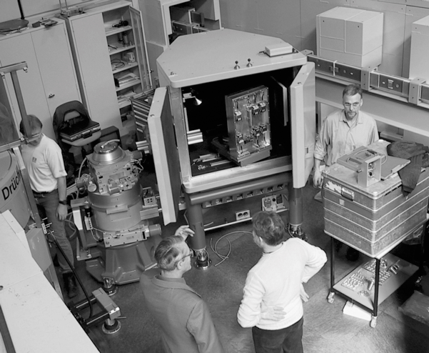
Detectors

Slide 16
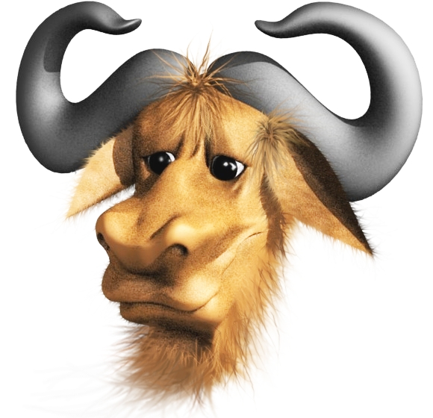
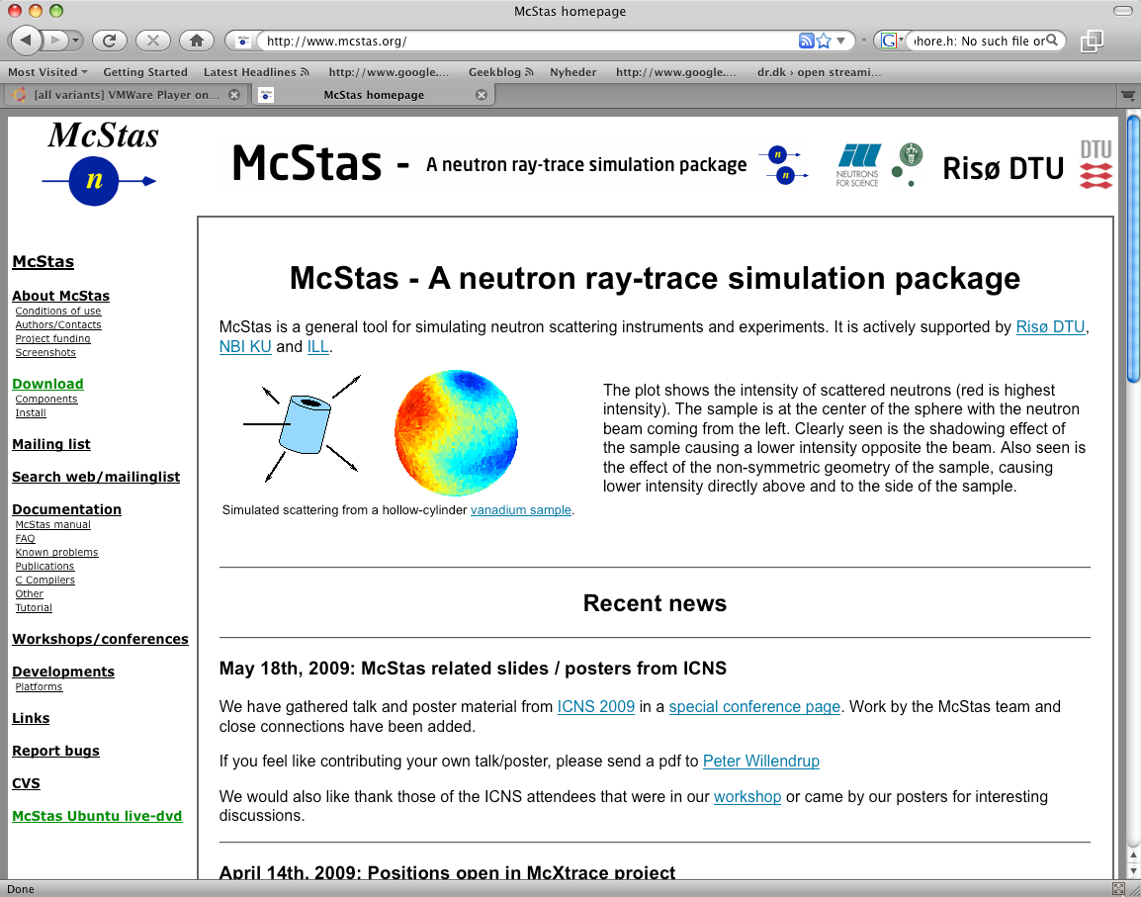
McStas Introduction
Flexible, general simulation utility for neutron scattering experiments.
Original design for Monte carlo Simulation of triple axis spectrometers
Developed at DTU Physics, ILL, PSI, Uni CPH, ESS DMSC
V. 1.0 by K Nielsen & K Lefmann (1998) RISØ
Currently 2.5+1 people full time plus students
GNU GPL license
Open Source
Project website at
http://www.mcstas.org
mcstas-users@mcstas.org mailinglist

Slide 17
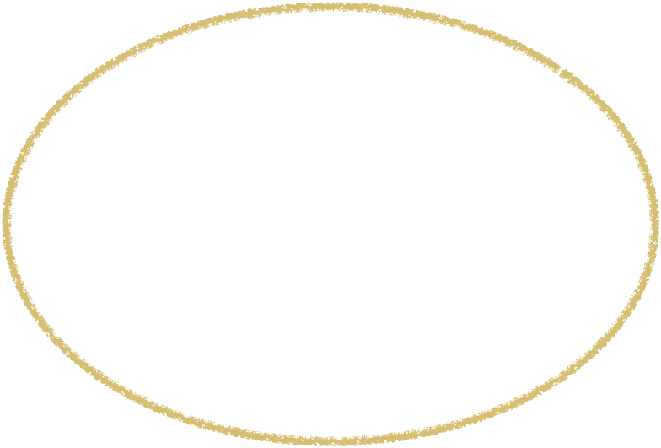

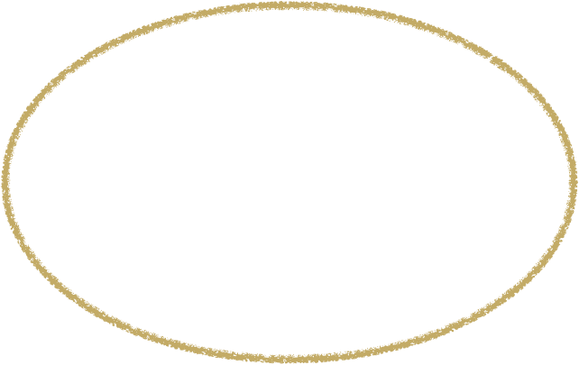


McStas Introduction
Flexible, general simulation utility for neutron scattering experiments.
Original design for Monte carlo Simulation of triple axis spectrometers
Developed at DTU Physics, ILL, PSI, Uni CPH, ESS DMSC
V. 1.0 by K Nielsen & K Lefmann (1998) RISØ
Currently 2.5+1 people full time plus students
v. 1.0 1998 v. 2.5 2018
Project website at
http://www.mcstas.org
mcstas-users@mcstas.org mailinglist

Slide 18
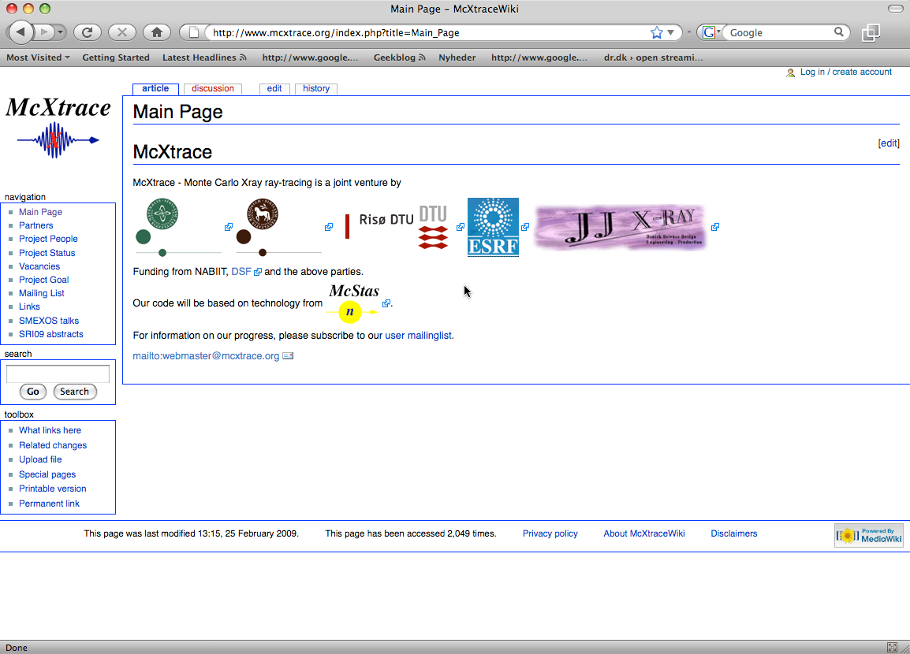
McStas Introduction
McXtrace - since jan 2009 similar for X-rays
Flexible, general simulation utility for neutron scattering experiments.
Original design for Monte carlo Simulation of triple axis spectrometers
Developed at RISØ DTU, KU and ILL, Grenoble.
V. 1.0 by K Nielsen & K Lefmann (1998)
Currently 2.5+1 people full time plus students
GNU GPL license
Open Source
Project website at
http://www.mcstas.org
neutron-mc@risoe.dk mailinglist
Synergy, knowledge transfer, shared infrastructure
4

Slide 19
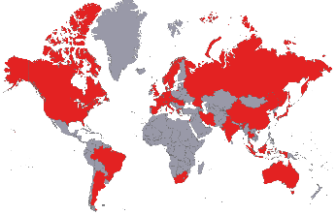
Used in many places

Slide 20
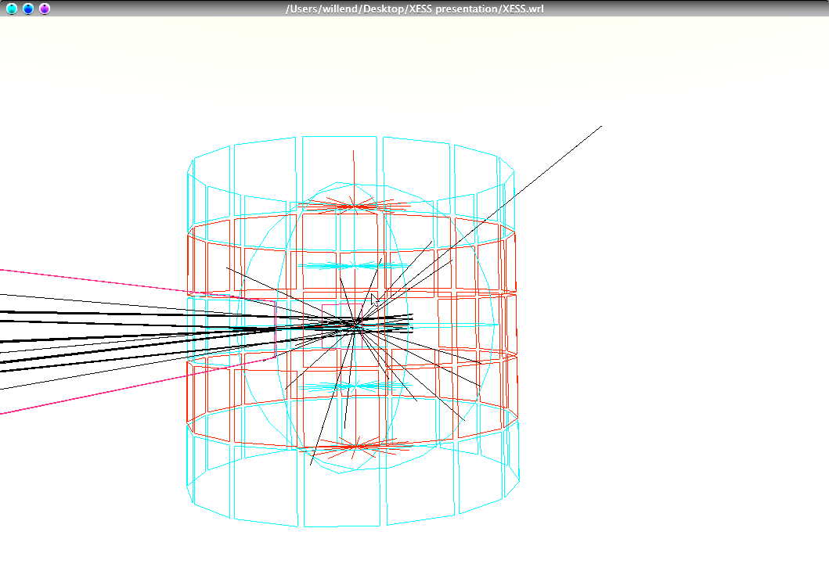
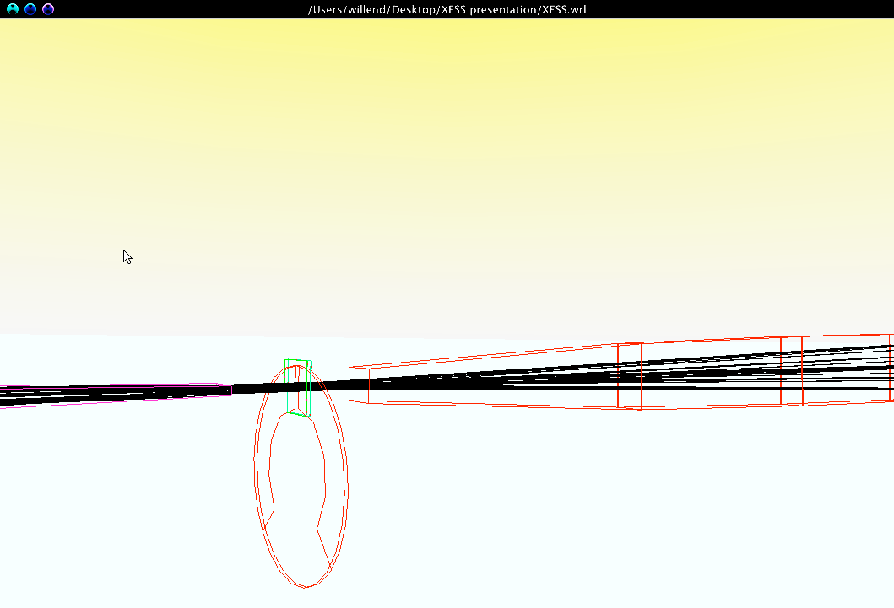
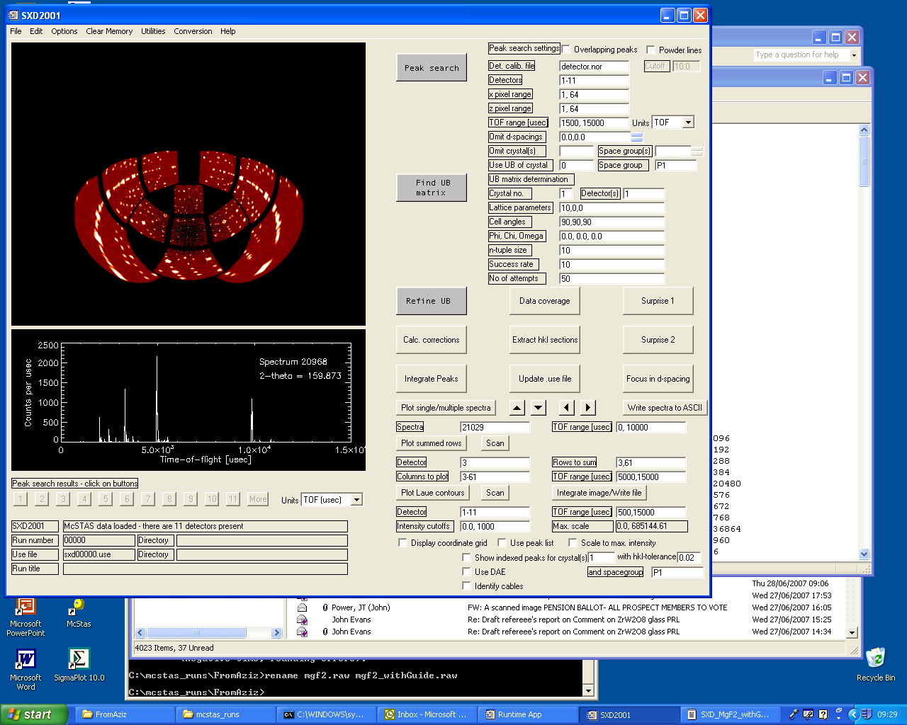
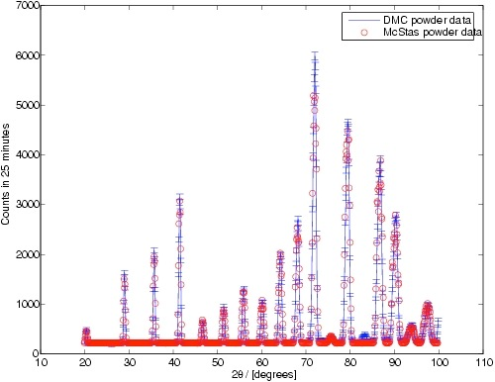
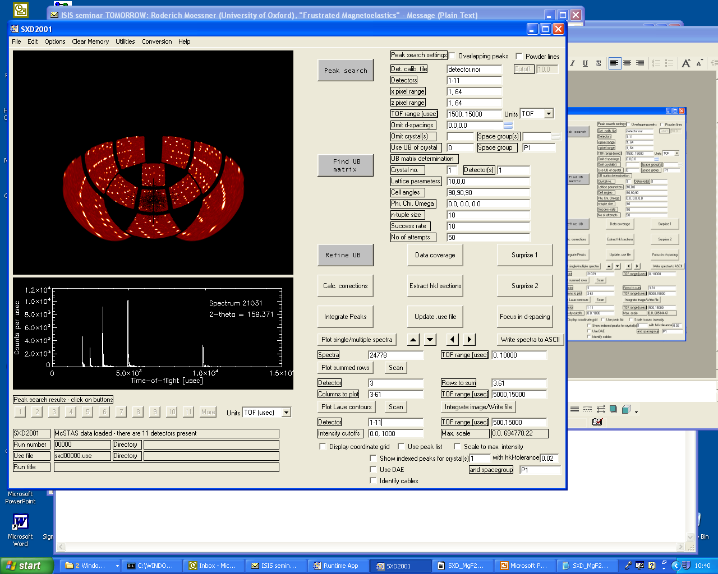
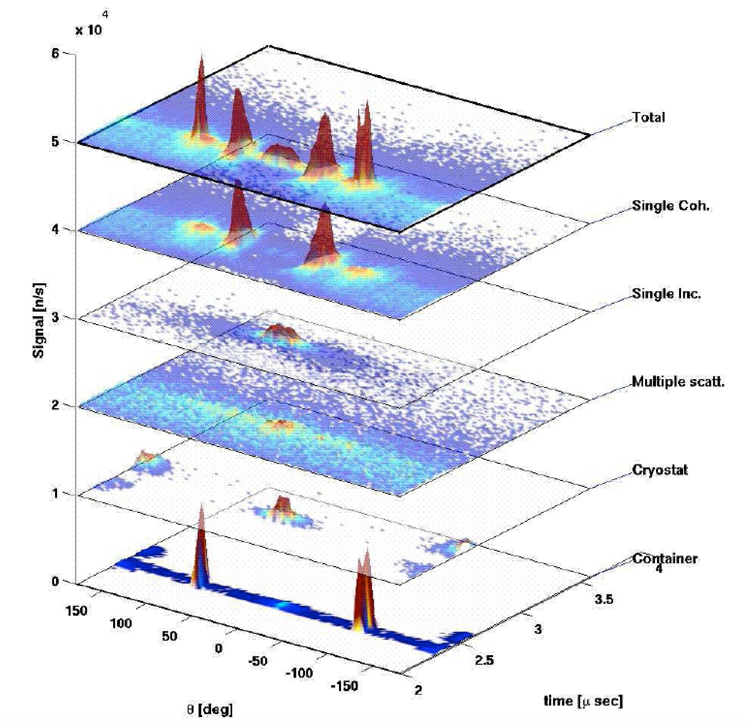
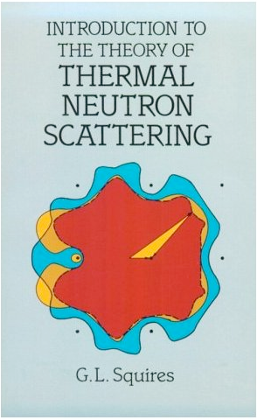
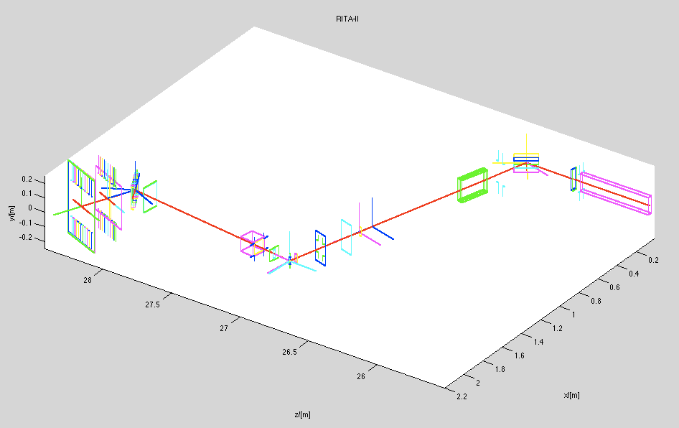

What is McStas used for?
Instrumentation
Planning
Construction
Virtual experiments
Data analysis
Teaching
(KU, DTU)

Slide 21


Reliability - cross comparisons
Much effort has gone into this
Here: simulations vs. exp. at powder diffract. DMC, PSI
The bottom line is
McStas agree very well with other packages (NISP, Vitess, IDEAS, RESTRAX, ...)
Experimental line shapes are within 5%
Absolute intensities are within 10%
Common understanding: McStas and similar codes are reliable
E. Farhi, P. Willendrup et al., in preparation
P. Willendrup et al., Physica B, 386, (2006), 1032.

Slide 22





McStas: key concepts
MDANSE2018
Time (t)
n
n
Local, internal coordinate system!
MDANSE 2018, Puerto de la cruz, Tenerife

Slide 23

In the big picture…

Slide 24




McStas overview
Portable code (Unix/Linux/Mac/Windoze)
Ran on everything from iPhone to 1000+ node cluster!
'Component' files (~100) inserted from library
Sources
Optics
Samples
Monitors
If needed, write your own comps
DSL + ISO-C code gen.

Slide 25

Under-the-hood / inner workings
Domain-specific-language (DSL) based on compiler technology (LeX+Yacc)
Simple Instrument language ISO C
Component codes realizing beamline parts (including user contribs)
Library of common functions for e.g.
I/O
Random numbers
Physical constants
Propagation
Precession in fields
...
Code generation

Slide 26

Implementation

Slide 27


Instrument file

Slide 28



Component file

Slide 29



Generated c-code

Slide 30


Writing new comps or understanding existing is not that complex...
Check our long list of components and look inside... Most of them are quite simple and short... Statistics:
Number of lines of code per component - 203 comps in total
(update: 175)

Slide 31
Including user contribs
Well-developed community support
30-40% of existing and new additions are from users
No direct refereeing of the code, but these requirements:
At least one test-instrument
Meaningful documentation headers (in-code docs)
Contributions go in dedicated contrib/ section of library
Natural life-cycle of contrib’s
Bug-fixes are applied both by contributor and developers
If contributor becomes unavailable either:
Many users of comp: Promote to official components, e.g. in optics/
Few/no users of comp: Move to obsolete/ until next major release

Slide 32








Example suite: 169 instruments

Slide 33
Feedback and help
Please:
- Enroll to mcstas-users@mcstas.org
- Post your question there or to mcstas-support@mcstas.org
- There is no such thing as a stupid question!
- Like us on Facebook? :)

Slide 34

!!! DEMO TIME !!!

